Slide 1
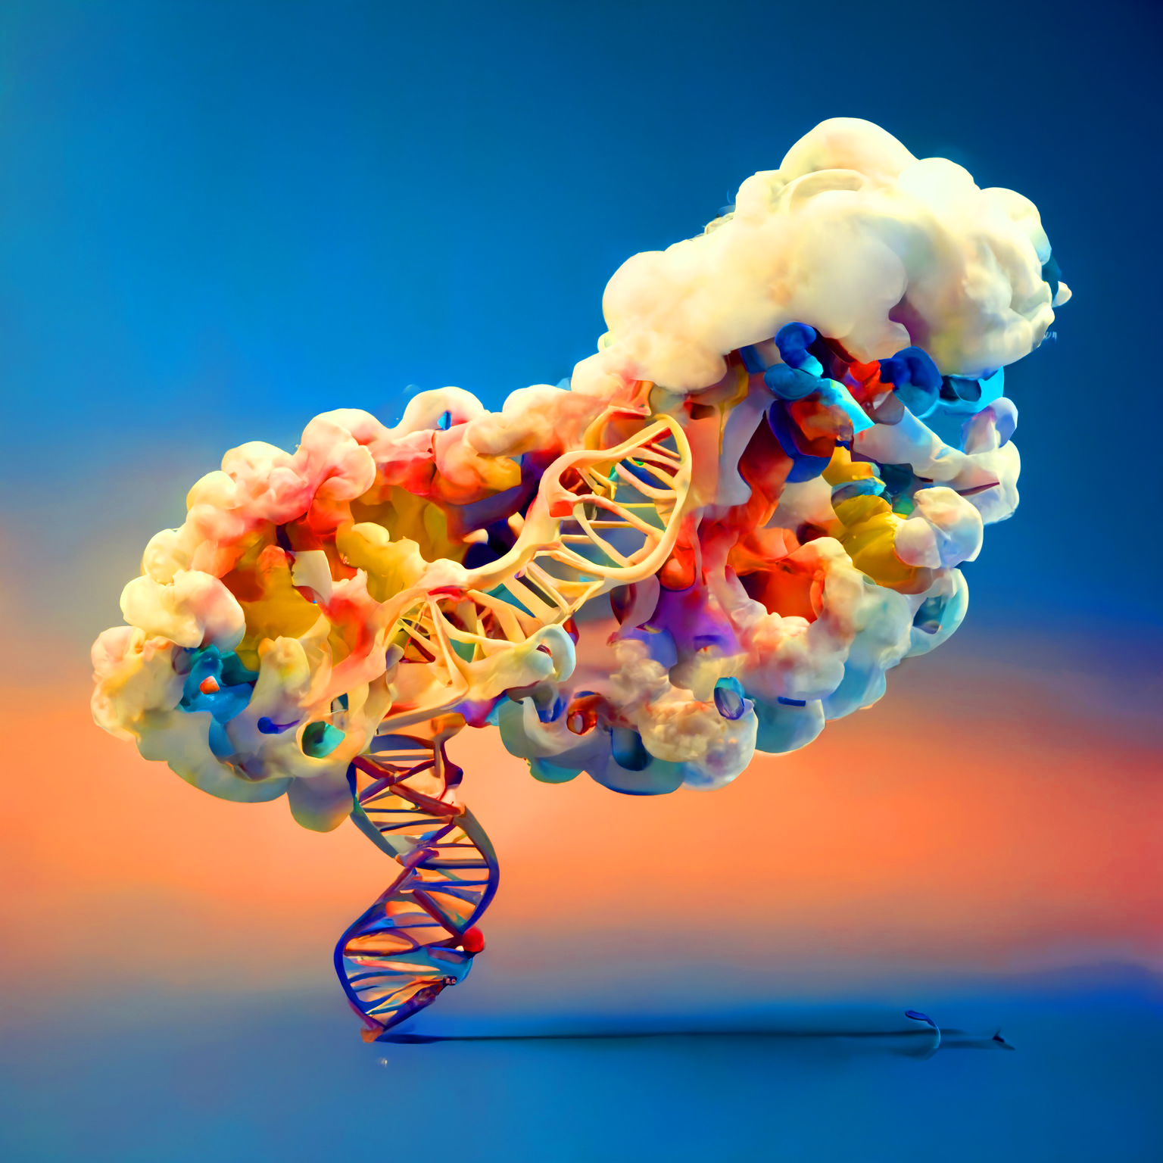
Succeed in the Life Sciences with R/Python and the Cloud
<Tuple>
Colby T. Ford, Ph.D.

Slide 2
Caveats and Considerations
Everything in this talk is public, but opinions are my own.
This talk references many of Microsoft services but is totally applicable to other clouds.
This content spans scientific, technical, academic, and industry viewpoints.

Slide 3
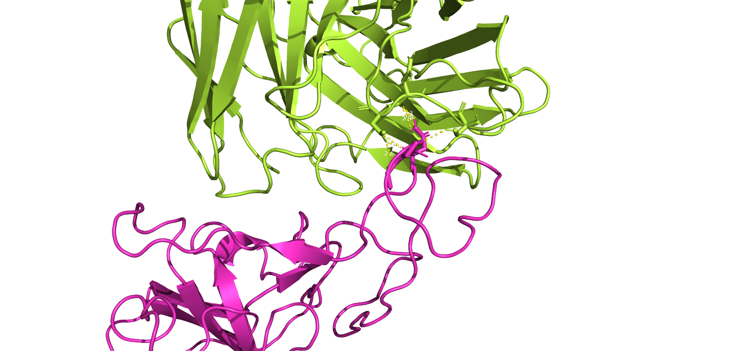
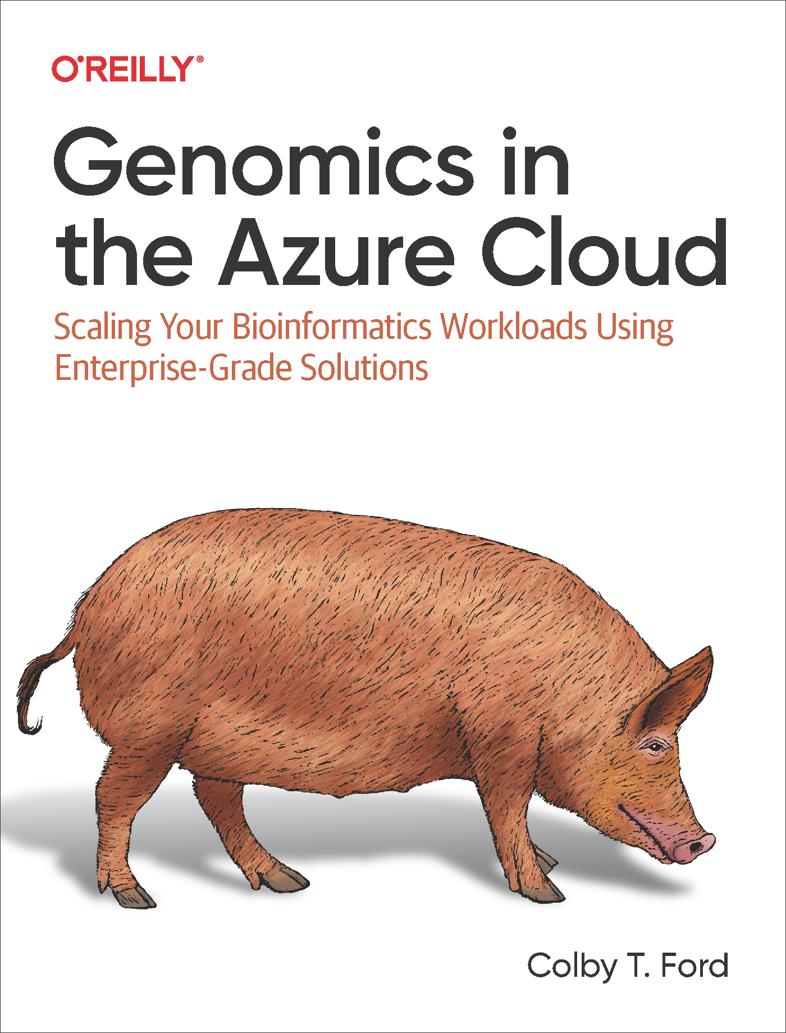



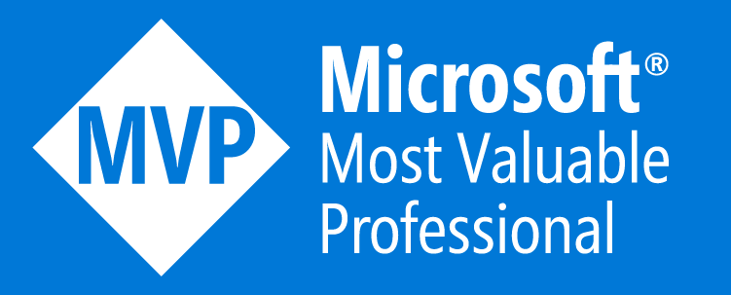
About Me
Colby T. Ford, Ph.D.
Computational Biologist and Cloud AI Architect
Founder, Principal Consultant
tuple.xyz
Co-Founder, V.P. Of Technology
amissa.com
Visiting Scholar, CIPHER Research Center
cipher.charlotte.edu
AzureGenomics.com
Research Interests:
Infectious diseases (SARS-CoV-2, Plasmodium sp., E. coli)
Human genomics (Oncology, rare diseases, etc.)
Protein structure design (mAbs, HLA-TCR, etc.)
Scalable cloud architectures, bioinformatics pipelines, bioAI

Slide 4
Talk Topics
Data Storage and Organization
Scaling Analyses with Cloud Compute
Case Study

Slide 5
Considerations For/Against the Cloud

Slide 6
Things That May Be Beneficial…
Cost
Speed
Scale
Productivity
Performance
Security
Eliminates the capital expenses of buying hardware and software.
Pay for what you use.
Self-service on-demand (Provision services in minutes).
Global availability of data and compute.
Grow/shrink to fit your needs.
Best-in-class security backend with tools to keep an eye on vulnerabilities and attacks.
Easy compliance and security offerings.
Latest generation hardware in datacenters.
Reduced latency for applications.
Less down time for set up, updates, and IT management.
Collaborative environment for your organization’s data and processes.
Fast services with little to no setup.

Slide 7
Beneficial Cloud Bits…
* not idiot proof
Scalability
Security*
Collaboration
Automation

Slide 8
Data Storage and Organization

Slide 9

“The Chair”
(Base Edition)

Slide 10

“The Chair”
(Real Edition)

Slide 11

“The Chair”
(Shelf Edition)

Slide 12

“The Chair”
(Ideal Edition)

Slide 13



datalake/
datalake01
Client (company_abc)
Client (company_def)
Project (project_001)
Project (project_002)
Project (project_101)
Study (study_001)
Study (study_002)
Study (study_101)
Run (sample-abc-123)
Data Type (exome)
Data Type (pathology)
Data Type (phenotypes)
sample-abc-123_pheno.json
Form (raw)
Form (completed)
sample-abc-123_labtest.csv
sample-abc-123_R1.fastq.gz
Output (alignments)
sample-abc-123_align.bam
Session (123)
Output (variants)
sample-abc-123_variants.vcf

Slide 14
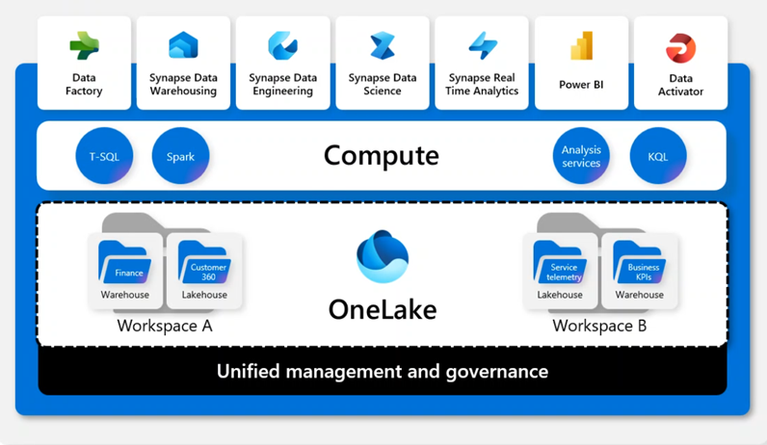
Data Lakes and Lakehouses OneLake: Unification to Break Down Data Siloes
Shared Compute
Data
Factory
Synapse Data
Warehousing
Synapse Data
Engineering
Synapse Data
Science
Synapse Real
Time Analytics
Power BI
Data
Activator
One Security
T-SQL
Spark
Compute
Analysis
Services
KQL
All-in on .Parquet
Research Outcomes
Experiment
360
Variant
Lakehouse
Clinical
Trial
360
Pro Tip:
Define Your
“Unit of Work”
Warehouse
Lakehouse
OneLake
Lakehouse
Warehouse
Research Workspace
Omics Workspace
Unified Management and Governance

Slide 15


Why Organization Matters
Scalable Queries Across Your Data
Using tools like Azure Synapse Analytics or Azure Databricks, we can query across sets of files in a data lake
(as long as it’s organized).
“How many of the samples in Study B have Gene ERBB2 expression > 10 TPM across all RNA-seq analyses?”
“Return a combined list of all spectrophotometer readings for
Client Q’s studies in 2022.”
Azure Synapse
Analytics
“What is the average abundance ratio for all Proteomics runs for Protein P14678 across all of Client X’s projects?”
Azure Storage
(Data Lake)
Azure Databricks
datalake/project_A/study_B/rnaseq/*/completed/expression/*.csv

Slide 16






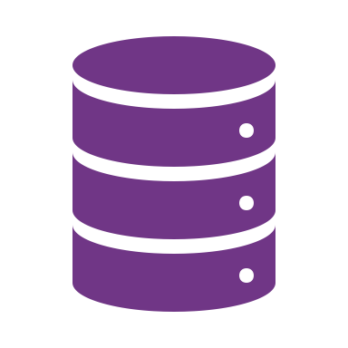











Example Architecture
Source
Ingest
Transform
Query and Process
Serve
Output
Data Governance
Data Workﬂows
Orchestration
Git, CI/CD
MLOps Stacks
Devices/ IoMT
Data Science and ML
Model Serving
Experiments,
AutoML,
Model Mgmt.
Serverless,
Real-Time Inferencing
Event Streaming
Lakehouse
Platform
Feature Store
Databases /
EHR Systems
Apps
Data Engineering / Engines
Data Warehouse
Operational
Database
Lab Results
Delta Live Tables
Auto Loader
Transform, Cleanse, Prepare
Azure
Synapse
AWS Redshift
Databricks
Snowflake
BI Tools /
Dashboards
Images
Data Sharing
20
Ingestion tool
Cloud Storage /
Data Lake
Delta Sharing
3rd Parties
-omics
Text Data / Notes

Slide 17
Scaling Analyses with Cloud Compute

Slide 18




Why Cloud Compute?
Elastic Scalabilty
Some Azure Compute Services:
Orchestrate Complex Data Transformations and Analyses
Azure Synapse
Analytics
Azure Kubernetes
Service
Automate Repetitive Tasks
Azure Databricks
Azure Functions
Enable Analytical Collaboration
Improve Scientific Reproducibility
Azure Machine Learning
Azure HPC Services

Slide 19
Running R/Python IDEs on…
Azure Machine Learning
Azure Databricks

Slide 20
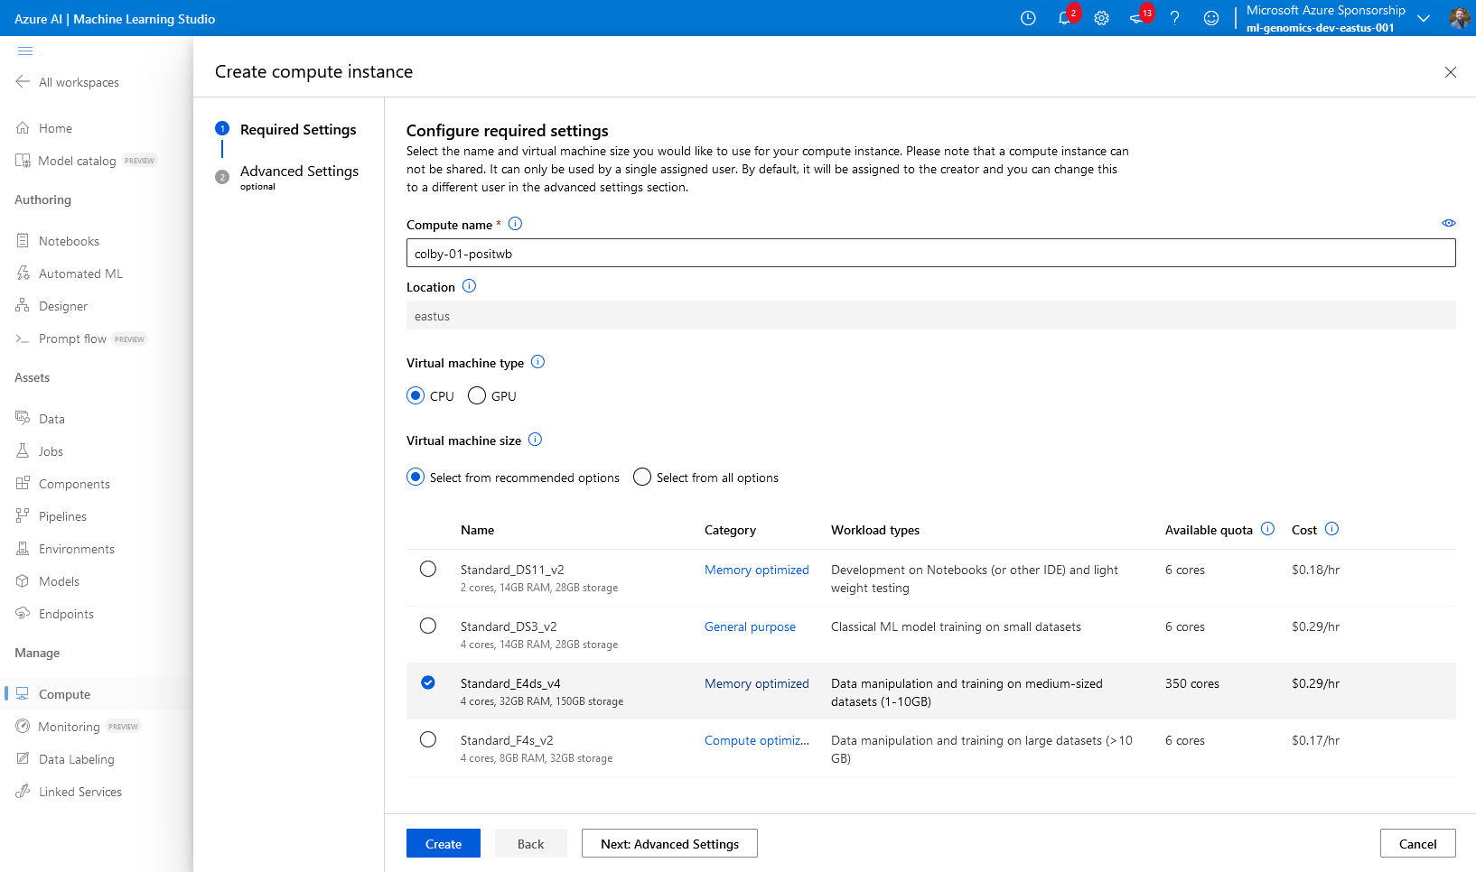

Azure Machine Learning
Create a Compute Instance

Slide 21
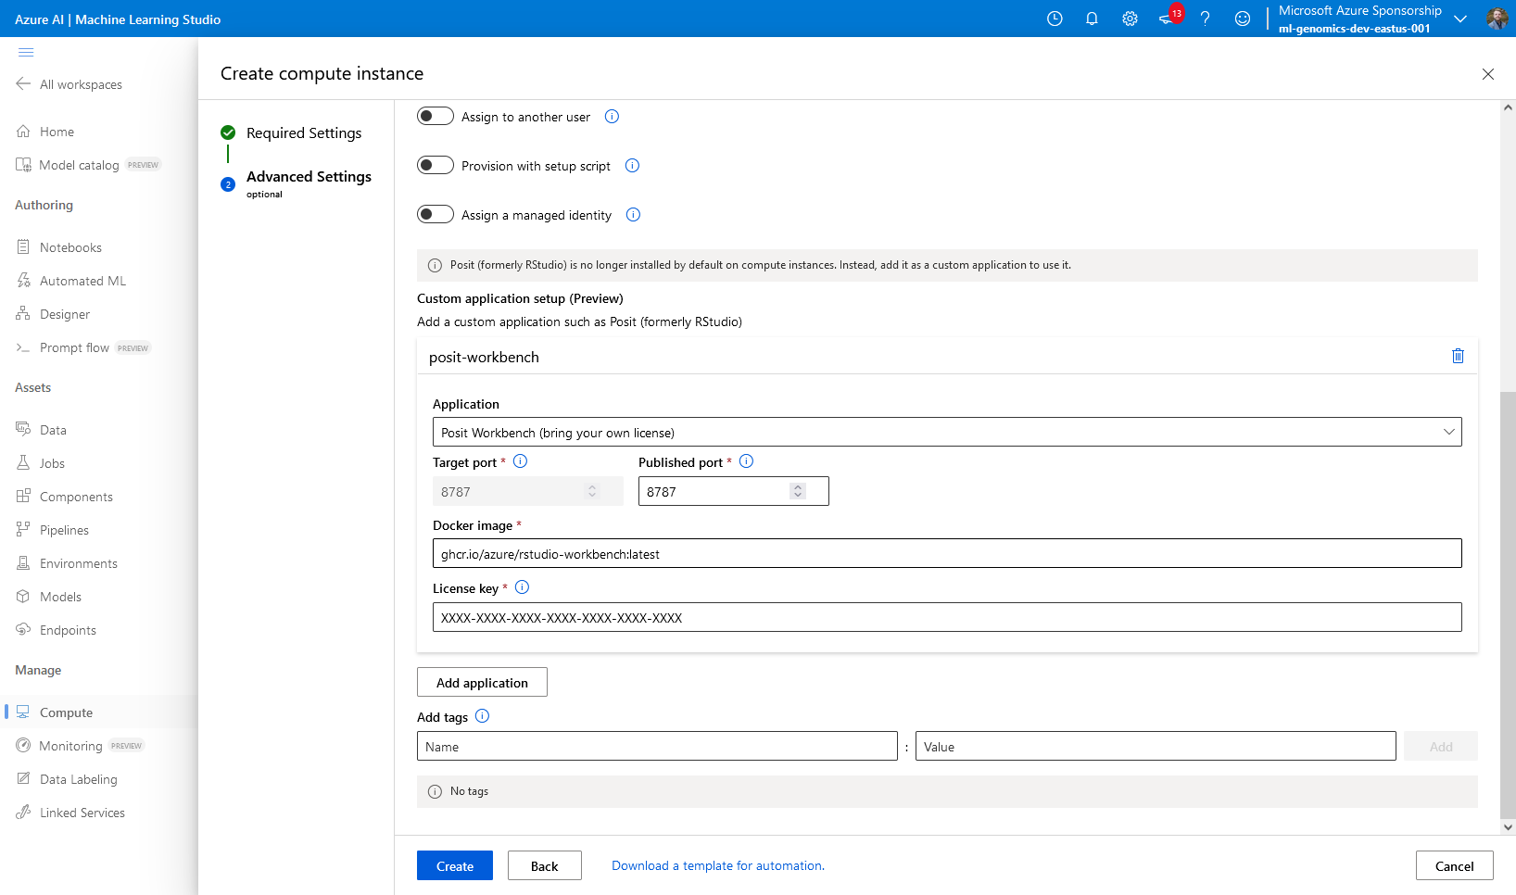

DockerHub: rstudio/rstudio-workbench
Azure Machine Learning
A
Use a Docker Image
(in Advanced Settings)
Posit Workbench BYOL

Slide 22
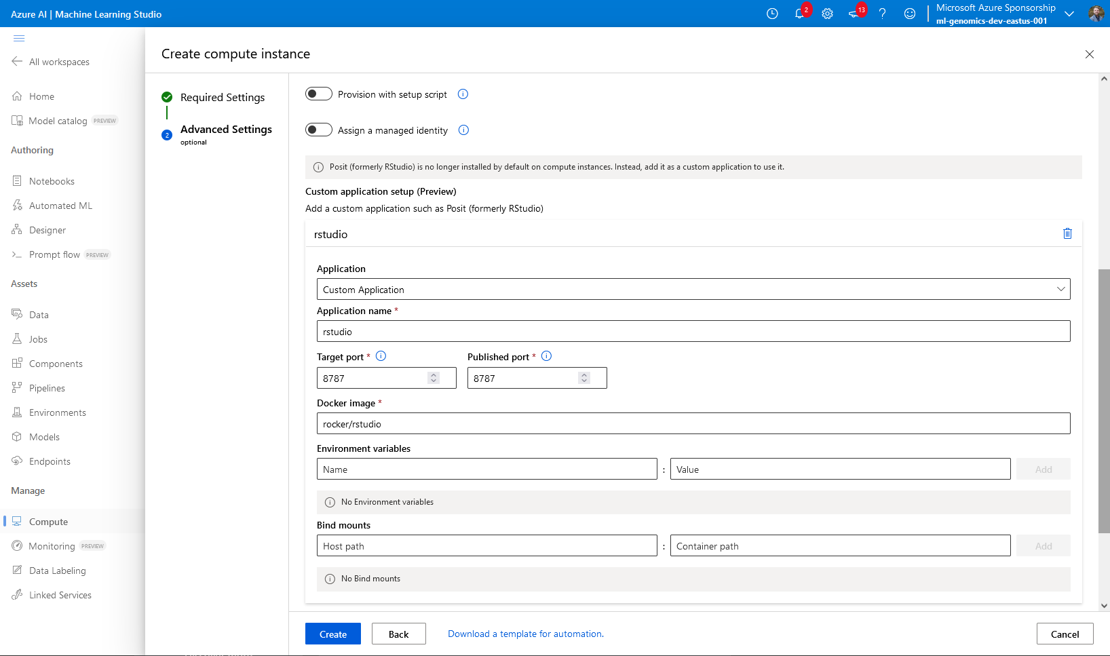
DockerHub: rocker/rstudio
Azure Machine Learning
B
Use a Docker Image
(in Advanced Settings)
Rocker RStudio Server (Open-Source)

Slide 23
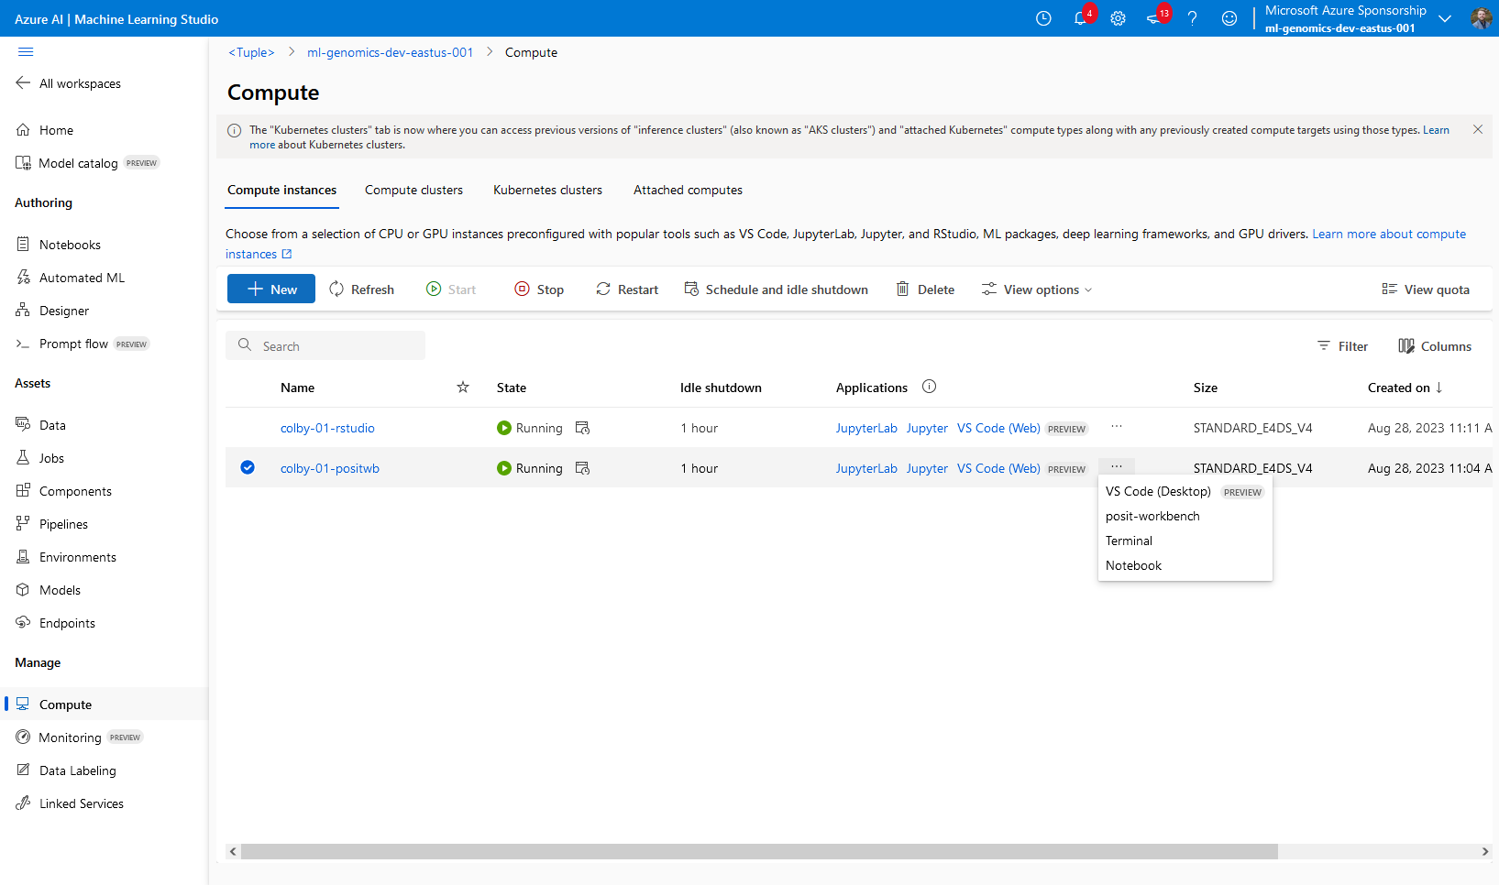

Azure Machine Learning
Open
the IDE
(in Applications)

Slide 24




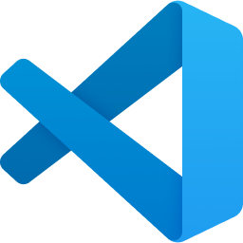
What’s Included?
as of August 2023
Azure Machine Learning
…in Azure ML Compute Instances
…with the Posit Workbench Image
Python
3.8 & 3.10
R
4.3.0
Python
???
R
4.1.2
RStudio Workbench
2022.07.0
JupyterLab
3.2.4
VSCode
1.81.1
JupyterLab
2.3.2
VSCode
???

Slide 25
What’s Included?
as of August 2023
Azure Machine Learning
…in Azure ML Compute Instances
…with the ‘jammy’ Posit Workbench Image
Python
3.8 & 3.10
R
4.3.0
Python
3.10.12
R
4.2.3
RStudio Pro
2023.06.1
JupyterLab
3.2.4
VSCode
1.81.1
JupyterLab
3.6.5
VSCode
4.12.0

Slide 26
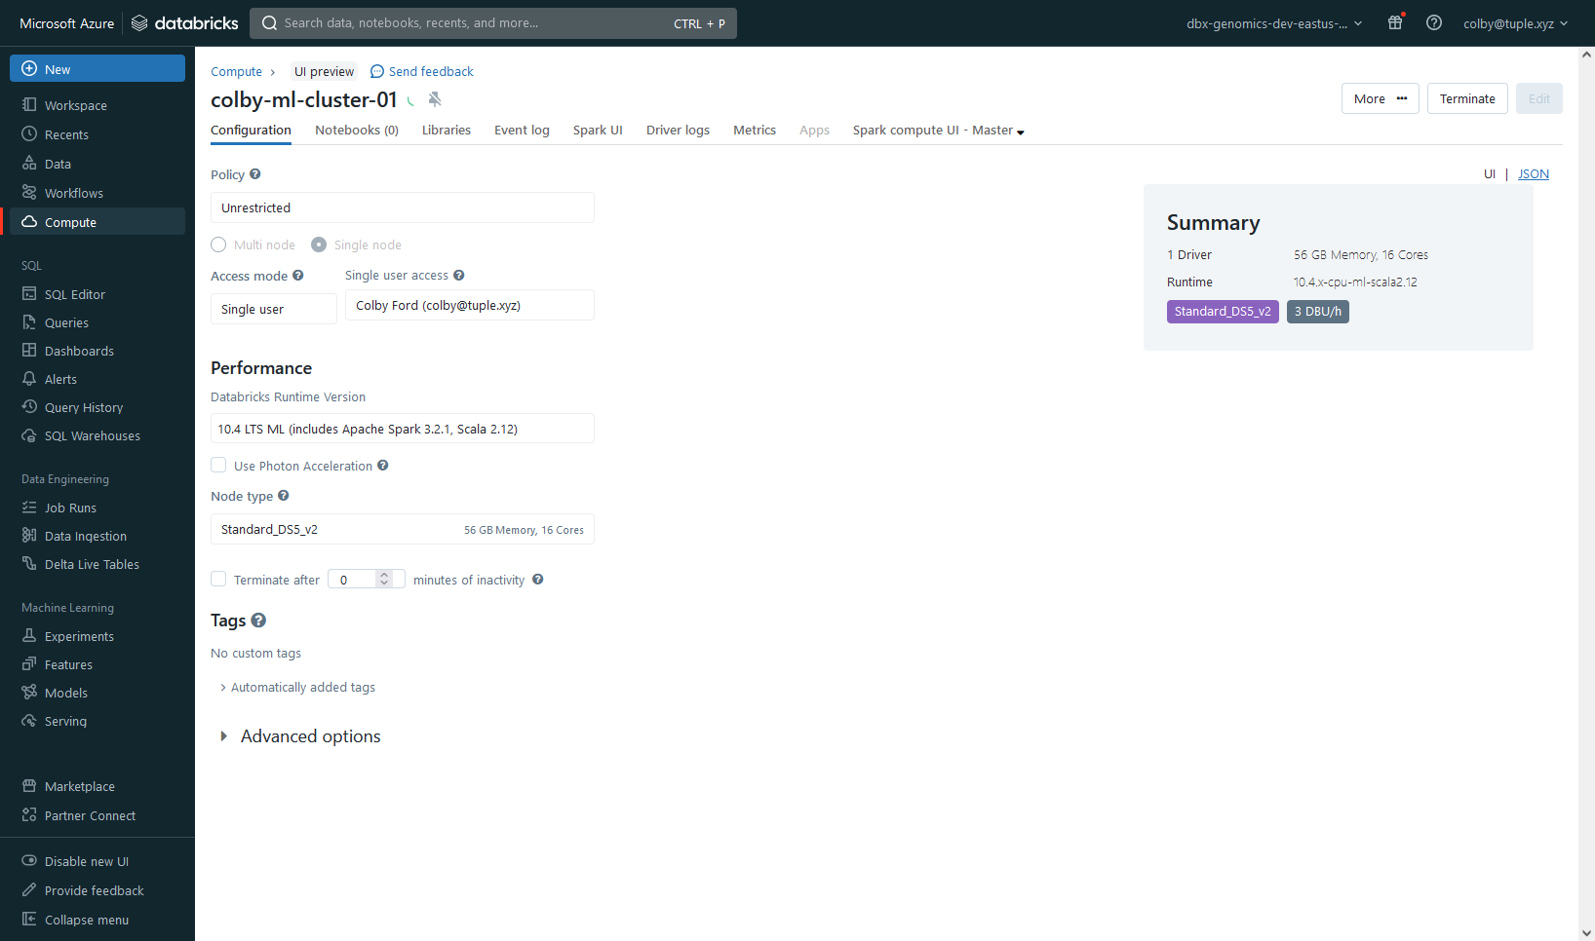
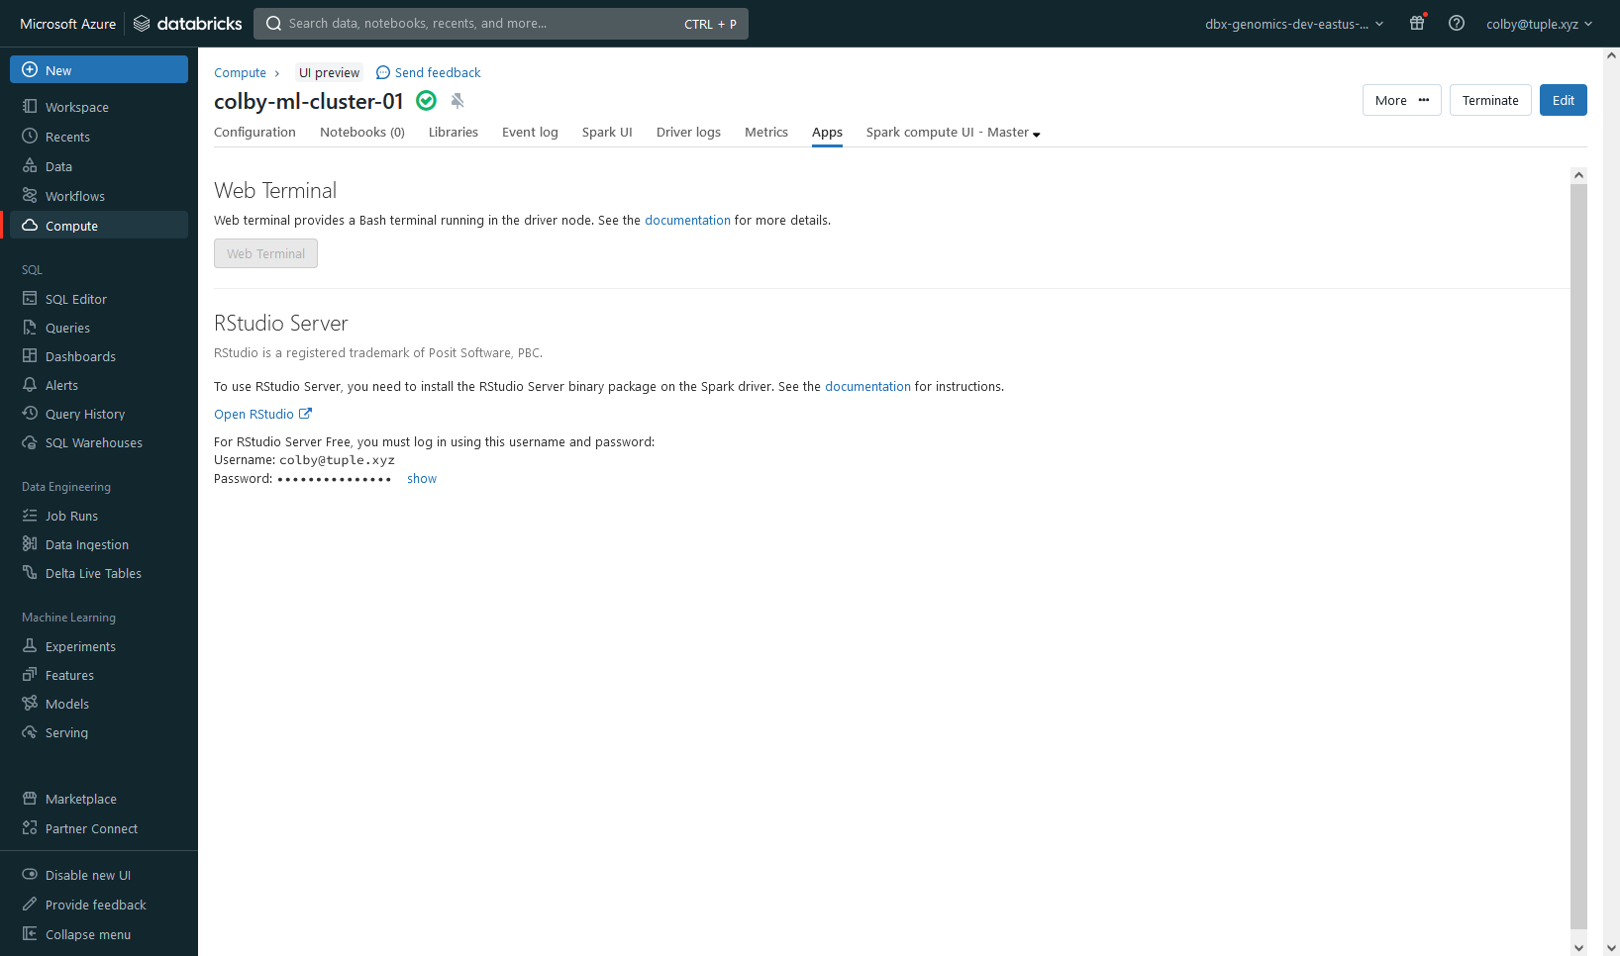
Azure Databricks
Create a Cluster
(w/ ML Runtime)

Slide 27
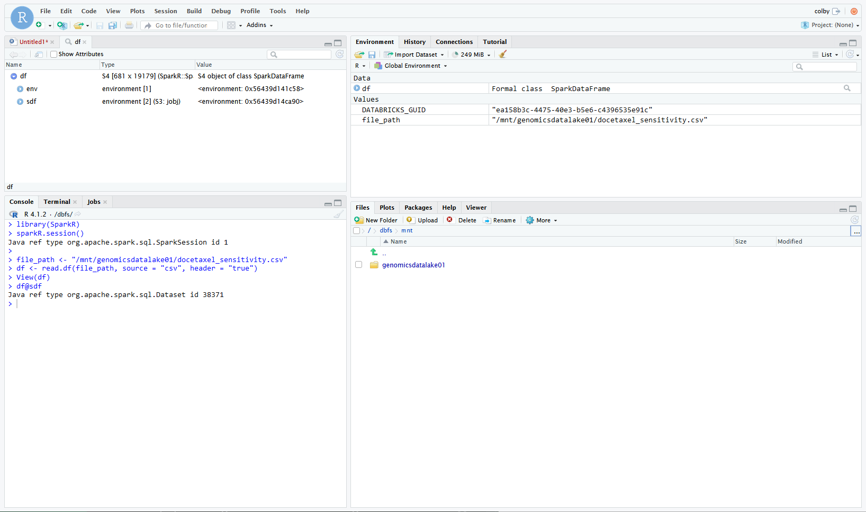
Azure Databricks
A
Use RStudio Server

Slide 28
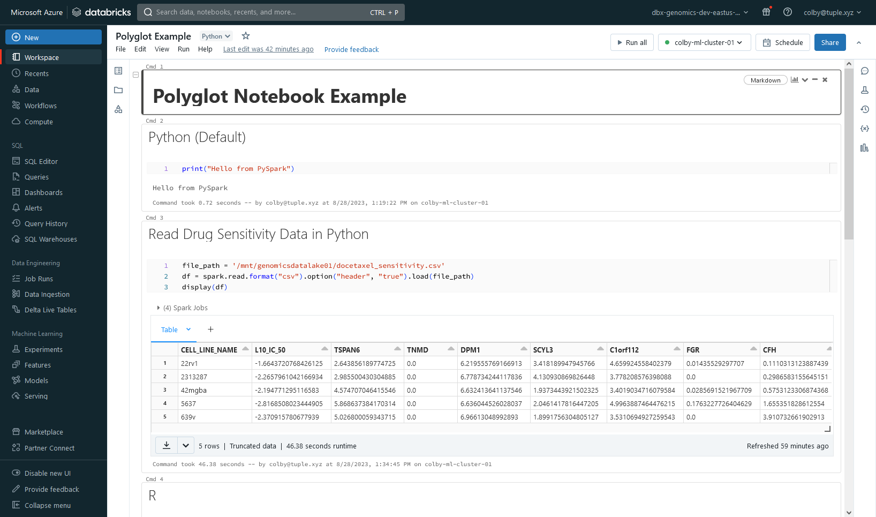
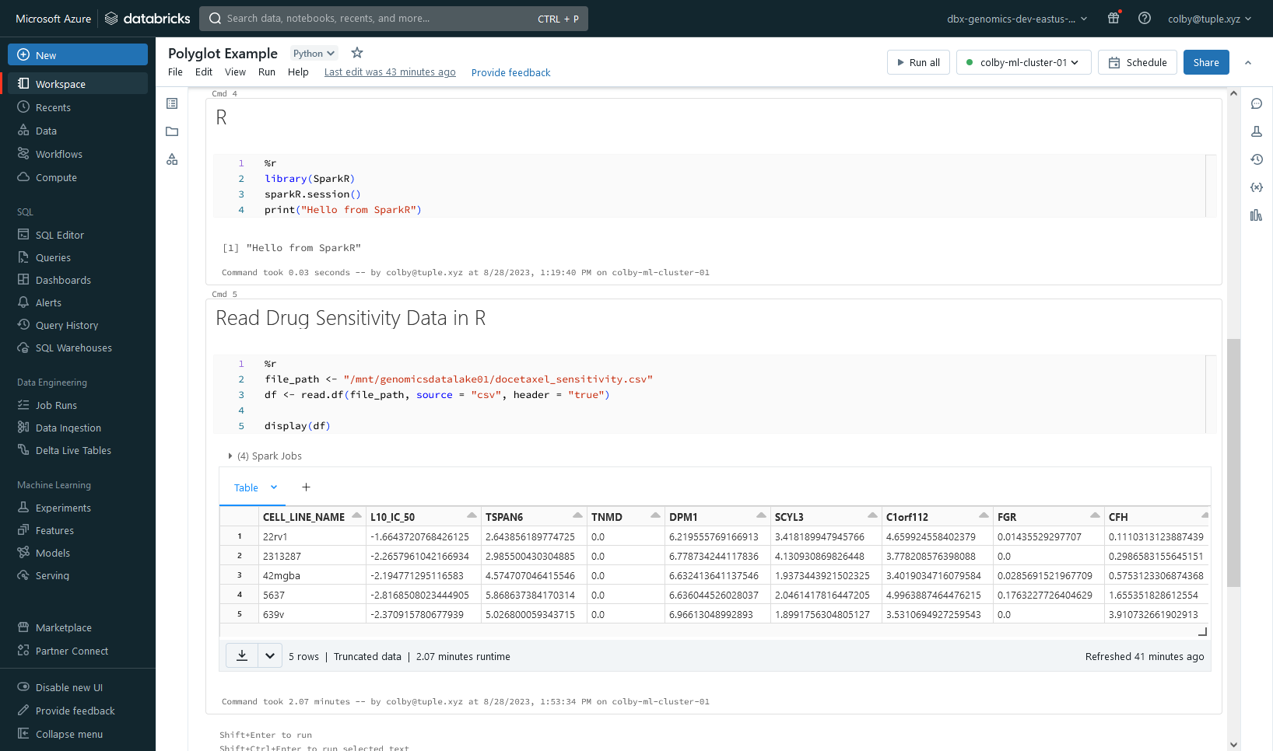
Azure Databricks
B
Use the Databricks Notebook
Switch between R, Python, Scala, SQL, Shell, Markdown…

Slide 29
Case Study

Slide 30
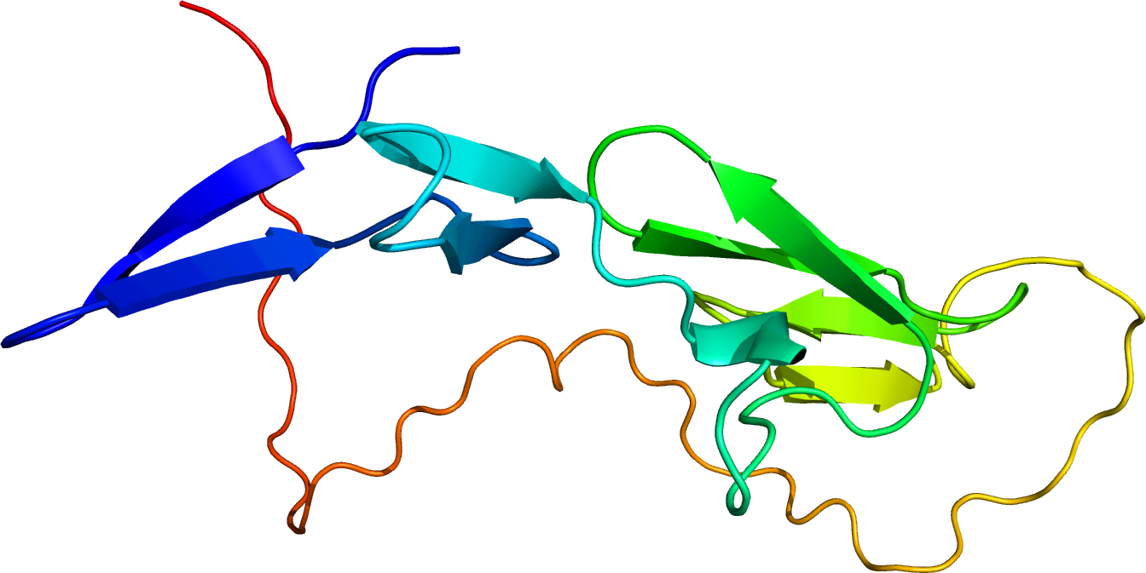
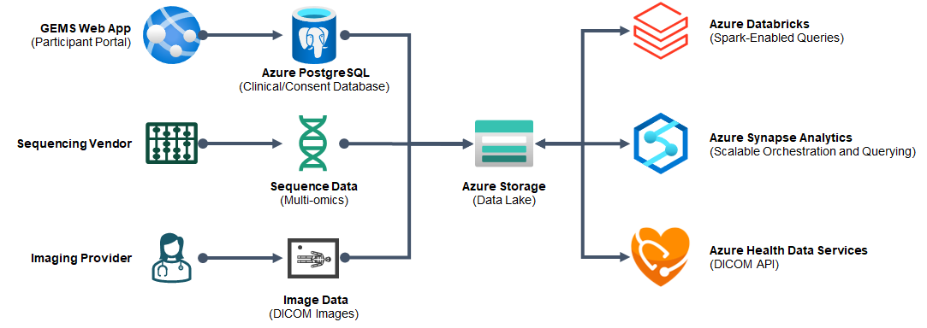
Fondation 101 Génomes
Belgium-based rare disease research foundation
First disease: Marfan syndrome
Solution: Data lake-centric design with analyses housed in Databricks and Synapse

Slide 31
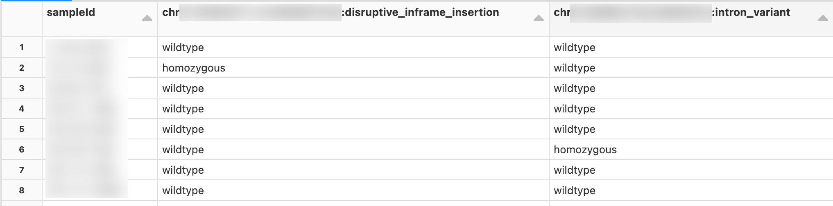
Fondation 101 Génomes
18 Seconds
10 Seconds
17 Minutes
WGS Samples:
49 Marfan +
112 Control
Read in variant (VCF) data
Filter to gene / region of interest
Pivot by variant and report zygosity

Slide 32
In Summary…
Running workloads in the cloud offers scalability, flexibility, and automation.
Data lakes offer a single source for your data, but it needs to be organized to be useful.
Connected compute services allow for you to retrieve data from your sources in a similar way to working locally.

Slide 33





Questions?
Connect with Me:
colby@tuple.xyz
@colbyford
<Tuple>

